Slide 1
MIAMI-DADE COUNTY PUBLIC SCHOOLS
OFFICE OF COMMUNITY EDUCATION AND BEFORE / AFTER SCHOOL PROGRAMS
PAGE 01
Notes:
WELCOME

Slide 2
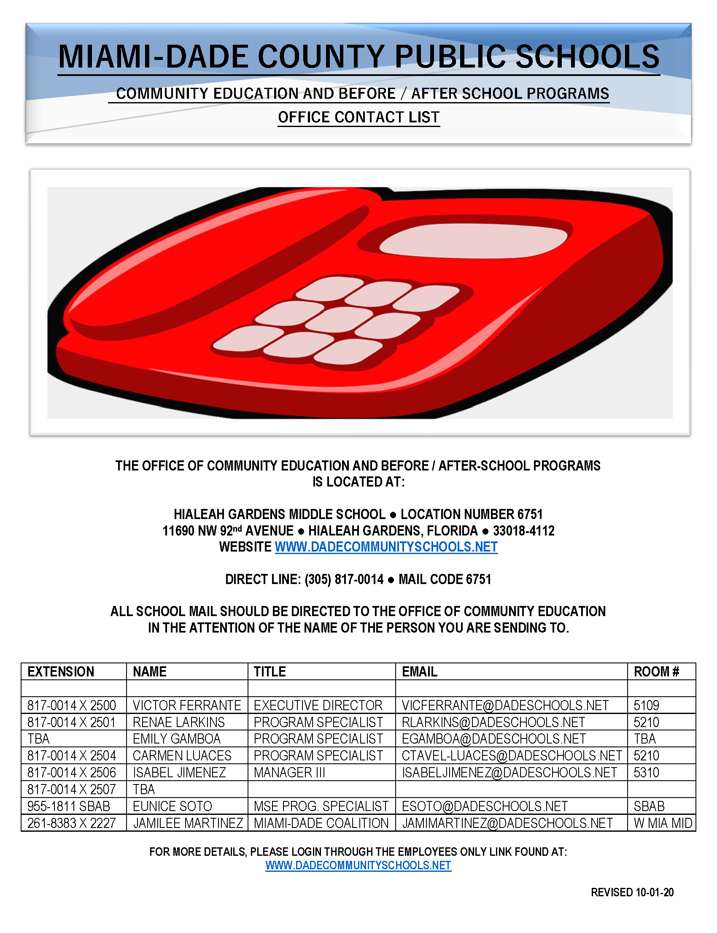
THE OFFICE OF COMMUNITY EDUCATION AND BEFORE AND AFTERSCHOOL PROGRAM STAFF ARE AVAILABLE TO STUDENTS, PARENTS, AND STAFF:
MONDAY THROUGH FRIDAY FROM
9:00 AM TO 4:30 PM
MIAMI-DADE COUNTY PUBLIC SCHOOLS
OFFICE OF COMMUNITY EDUCATION AND BEFORE / AFTER SCHOOL PROGRAMS
PAGE 02
Notes:
MEMO FOR YOUR TRAINING RECORD

Slide 3
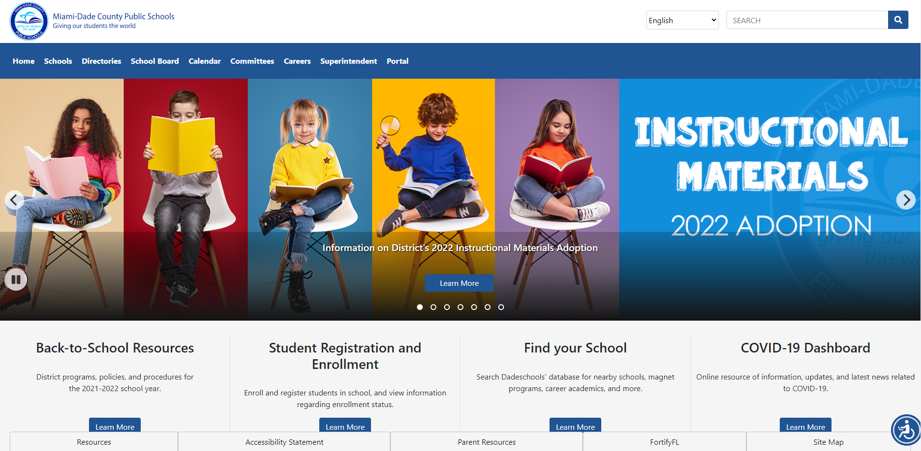
THE FOCUS REGISTRATION AND PAYMENT SYSTEM PORTAL CAN BE ACCESSED USING ANY OF THE FOLLOWING
3 WEB LINKS.
VIA A DESKTOP COMPUTER AT:
WWW.DADESCHOOLS.NET
CLICK ON THE PARENT PORTAL
YOU CAN ONLY USE THE FOLLOWING BROWSERS ACCESS FOCUS.
1
1
MIAMI-DADE COUNTY PUBLIC SCHOOLS
OFFICE OF COMMUNITY EDUCATION AND BEFORE / AFTER SCHOOL PROGRAMS
PAGE 03
Notes:
MEMO FOR YOUR TRAINING RECORD

Slide 4
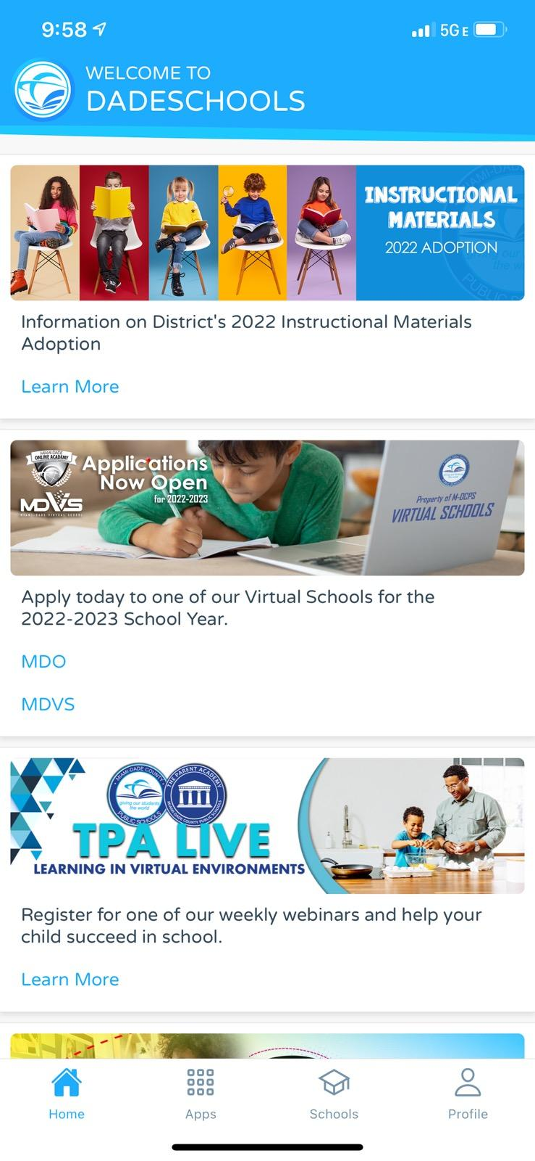
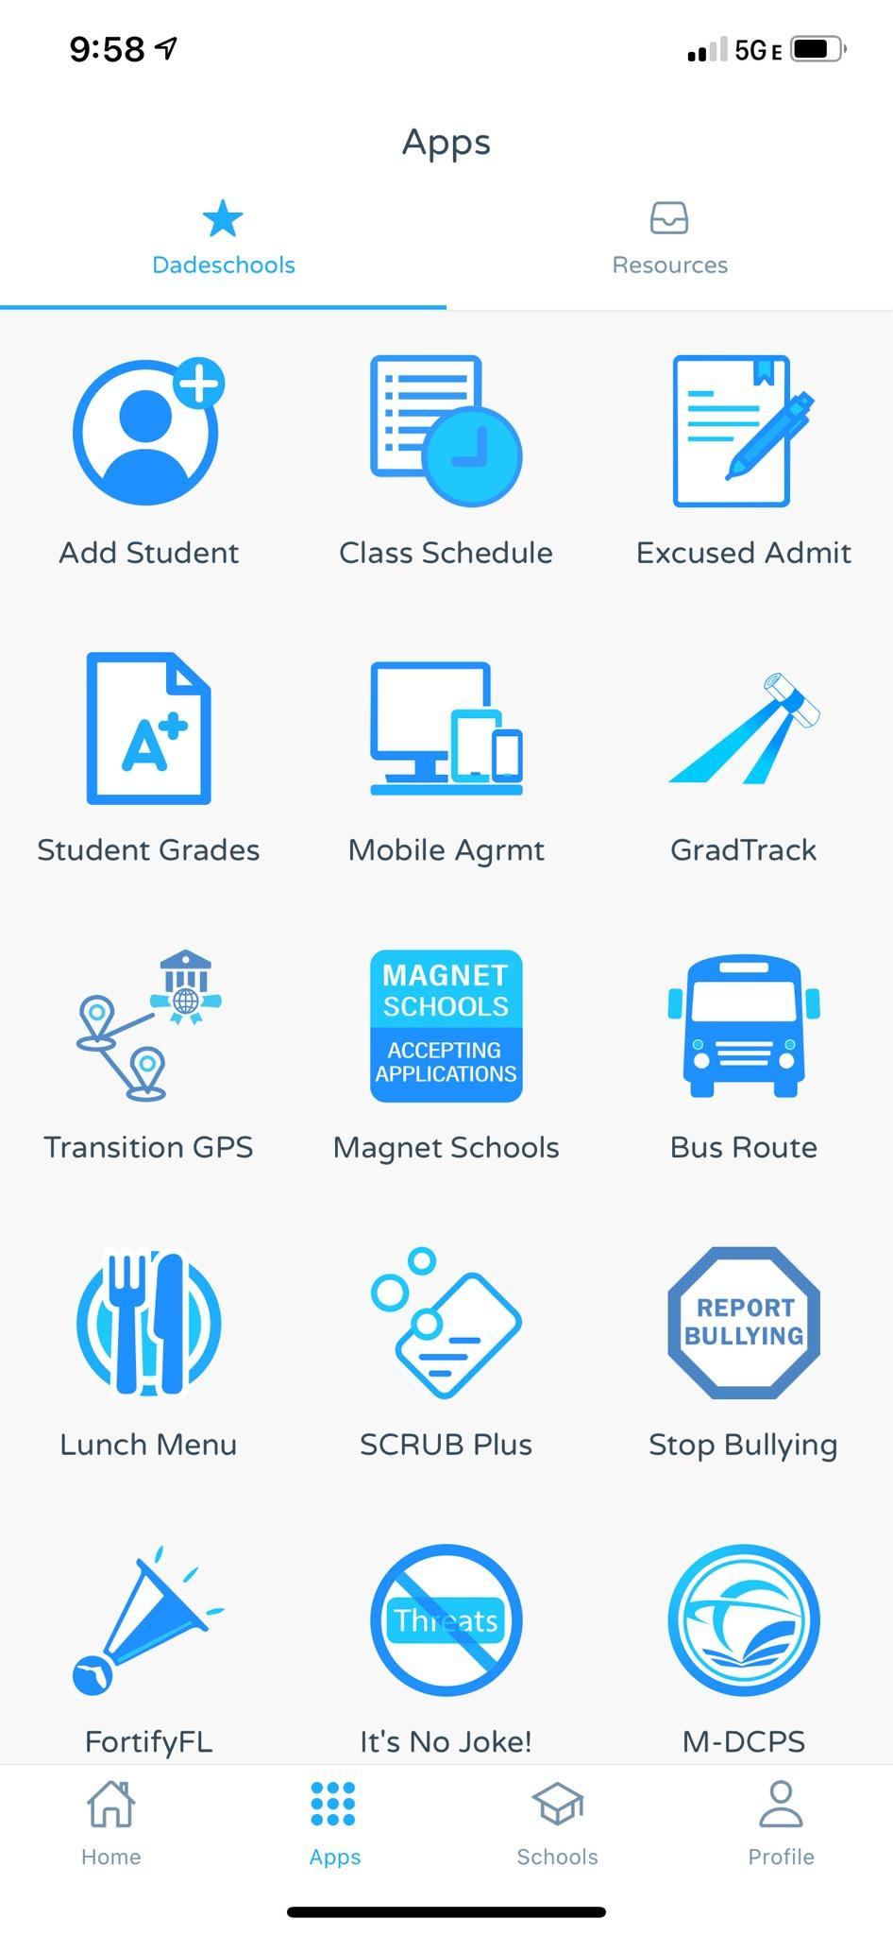
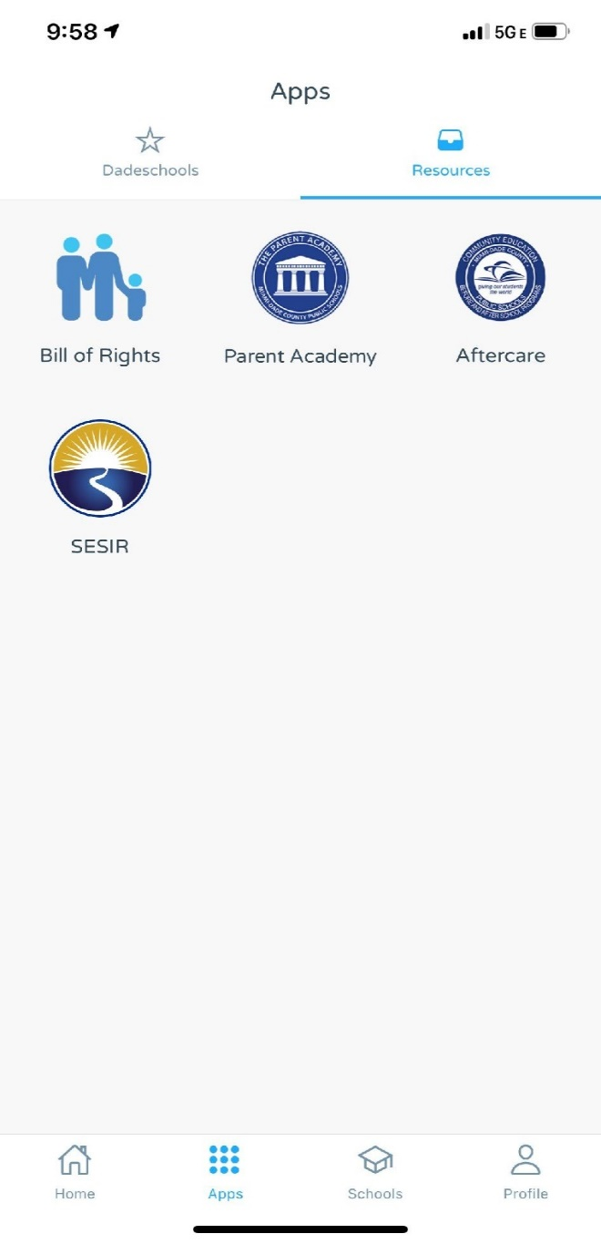
2
THE FOCUS REGISTRATION AND PAYMENT SYSTEM PORTAL CAN BE ACCESSED USING ANY OF THE FOLLOWING
3 WEB LINKS.
VIA THE DISTRICTS SMARTPHONE AFTERCARE APP. (PARENT PORTAL):
CLICK ON APPS / RESOURCES / AFTERCARE
2
MIAMI-DADE COUNTY PUBLIC SCHOOLS
OFFICE OF COMMUNITY EDUCATION AND BEFORE / AFTER SCHOOL PROGRAMS
PAGE 04
Notes:
MEMO FOR YOUR TRAINING RECORD

Slide 5
THE FOCUS REGISTRATION
AND PAYMENT SYSTEM PORTAL CAN BE ACCESSED USING ANY OF THE FOLLOWING
3 WEB LINKS.
VIA THE OFFICE OF COMMUNITY ED WEBSITE FOUND AT:
WWW.
DADECOMMUNITYSCHOOLS.
NET
3
3
REGISTRATION (POWERPOINT) CHEAT NOTES
MIAMI-DADE COUNTY PUBLIC SCHOOLS
OFFICE OF COMMUNITY EDUCATION AND BEFORE / AFTER SCHOOL PROGRAMS
PAGE 05
Notes:
MEMO FOR YOUR TRAINING RECORD

Slide 6
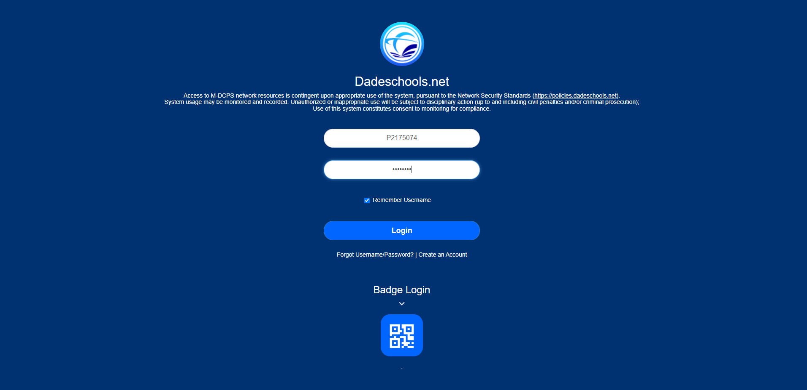
TO VIEW THE FOCUS REGISTRATION AND PAYMENT SYSTEM APP LINK VIA A DESKTOP COMPUTER:
THE PARENT AND STUDENT
MUST ALREADY BE LINKED TO THE
M-DCPS PARENT PORTAL.
THE FOCUS APP WILL ACTIVATE
WITHIN 24 TO 48 HOURS AFTER THE
M-DCPS PARENT PORTAL LINK IS COMPLETED.
ENTER YOUR USERNAME AND PASSWORD
AND CLICK THE LOGIN BUTTON
MIAMI-DADE COUNTY PUBLIC SCHOOLS
OFFICE OF COMMUNITY EDUCATION AND BEFORE / AFTER SCHOOL PROGRAMS
PAGE 06
Notes:
MEMO FOR YOUR TRAINING RECORD

Slide 7
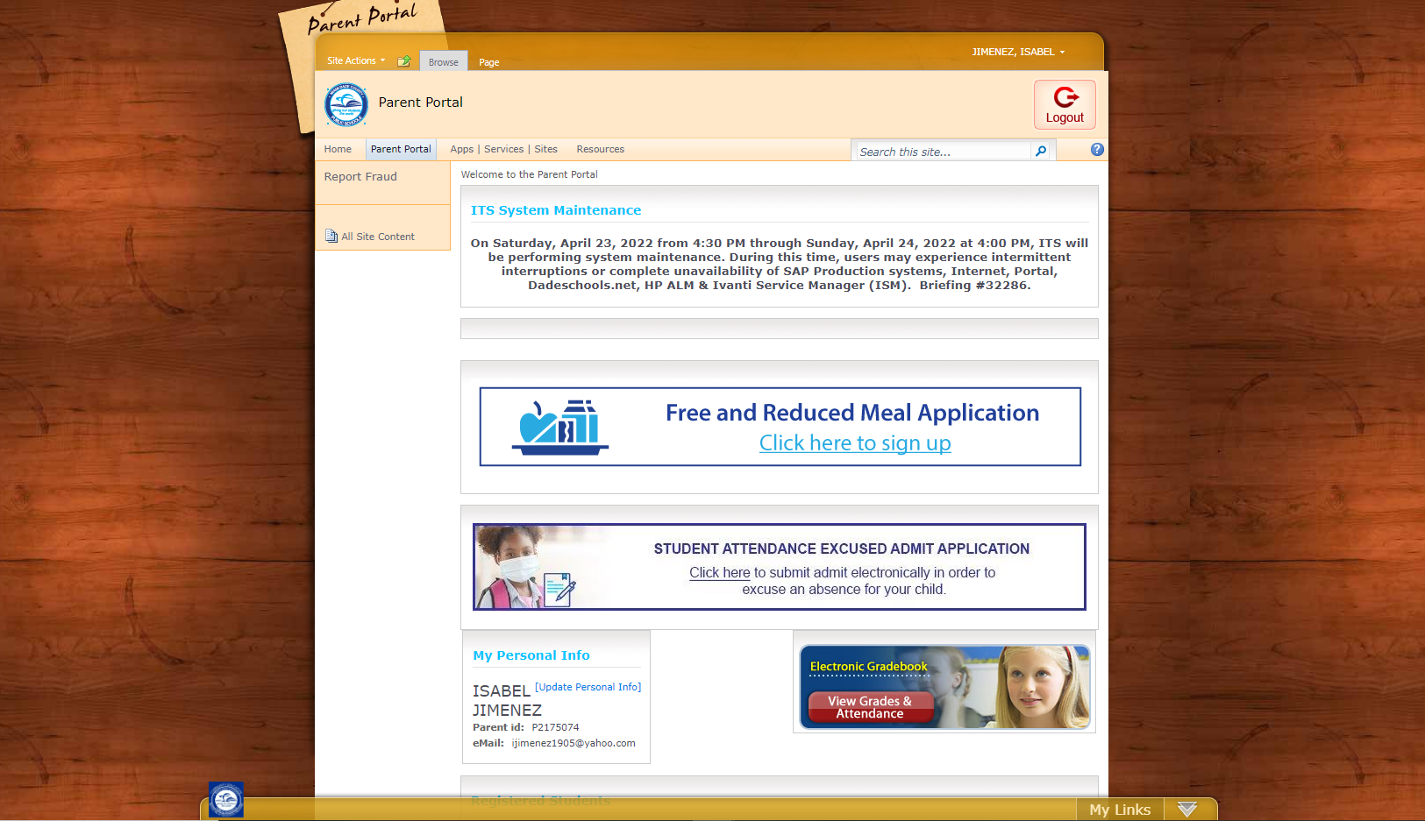
ONCE YOU HAVE LOGGED
IN TO THE M-DCPS PARENT PORTAL, CLICK ON THE
APPS / SERVICES / SITES
MIAMI-DADE COUNTY PUBLIC SCHOOLS
OFFICE OF COMMUNITY EDUCATION AND BEFORE / AFTER SCHOOL PROGRAMS
PAGE 07
Notes:
MEMO FOR YOUR TRAINING RECORD

Slide 8
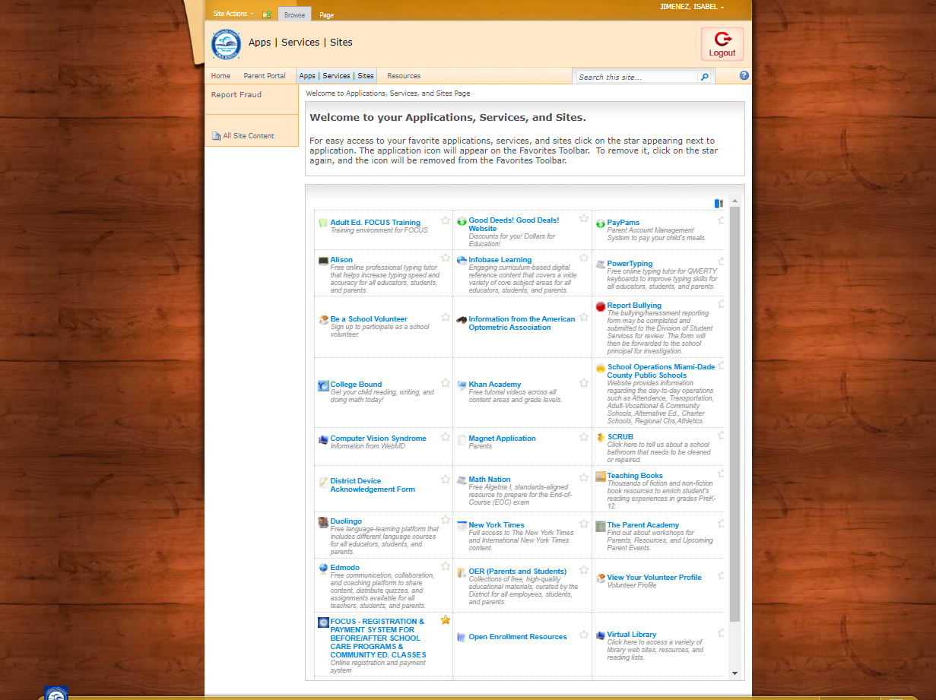
CLICK ON THE FOLLOWING APP:
IF YOU SEE THIS APP LINK, YOU ARE NOW READY TO EITHER REGISTER AND / OR MAKE A PAYMENT USING THE FOCUS SOFTWARE SYSTEM.
MIAMI-DADE COUNTY PUBLIC SCHOOLS
OFFICE OF COMMUNITY EDUCATION AND BEFORE / AFTER SCHOOL PROGRAMS
PAGE 08
Notes:
MEMO FOR YOUR TRAINING RECORD

Slide 9
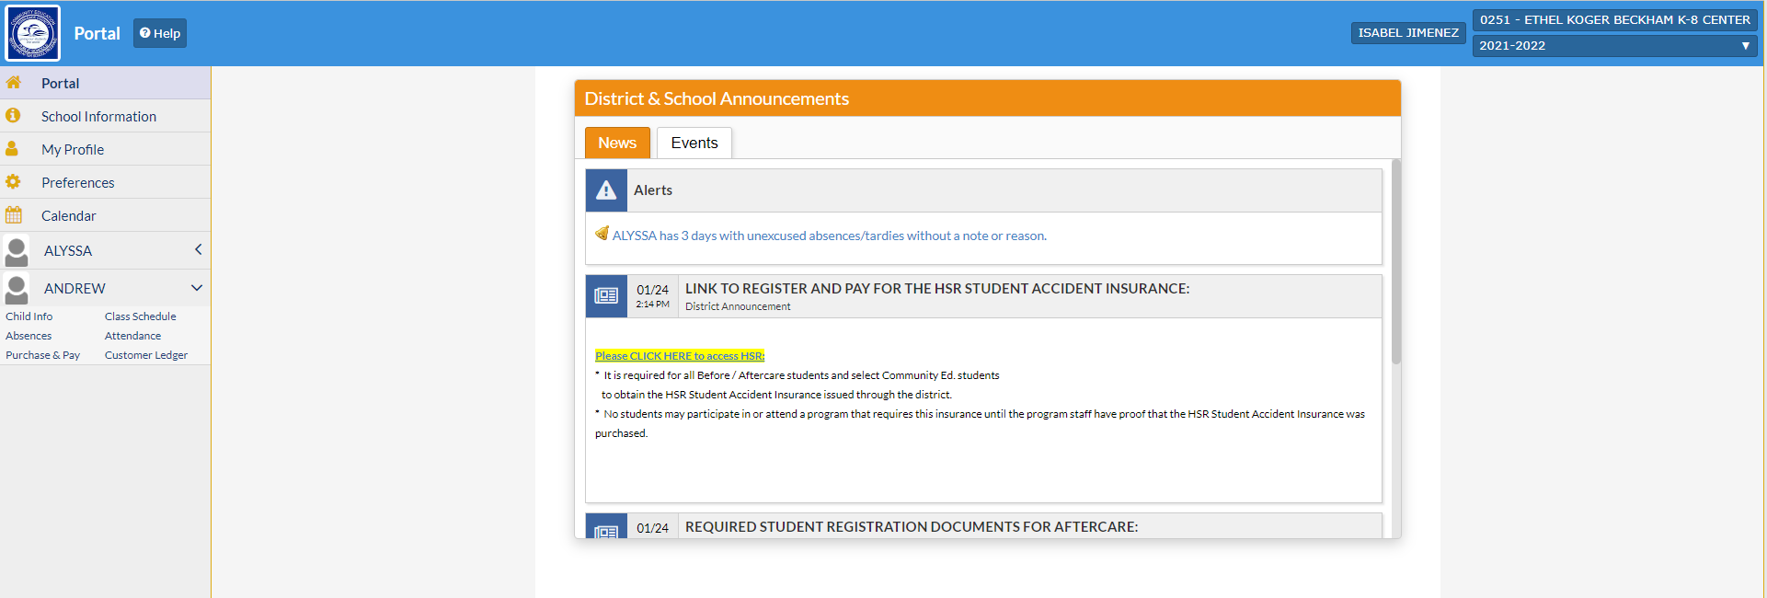
CLICK ON THE NAME OF YOUR CHILD THAT YOU WOULD LIKE TO REGISTER OR MAKE A PAYMENT FOR.
MIAMI-DADE COUNTY PUBLIC SCHOOLS
OFFICE OF COMMUNITY EDUCATION AND BEFORE / AFTER SCHOOL PROGRAMS
PAGE 09
Notes:
MEMO FOR YOUR TRAINING RECORD

Slide 10
ONCE YOU CLICK A NAME, A DROP-DOWN WILL OPEN UP.
CLICK ON
CHILD INFO.
MIAMI-DADE COUNTY PUBLIC SCHOOLS
OFFICE OF COMMUNITY EDUCATION AND BEFORE / AFTER SCHOOL PROGRAMS
PAGE 10
Notes:
MEMO FOR YOUR TRAINING RECORD

Slide 11
ONCE YOU CLICK ON
CHILD INFO.
THEN CLICK ON
EMERGENCY CONTACT INFORMATION
MIAMI-DADE COUNTY PUBLIC SCHOOLS
OFFICE OF COMMUNITY EDUCATION AND BEFORE / AFTER SCHOOL PROGRAMS
PAGE 11
Notes:
MEMO FOR YOUR TRAINING RECORD

Slide 12
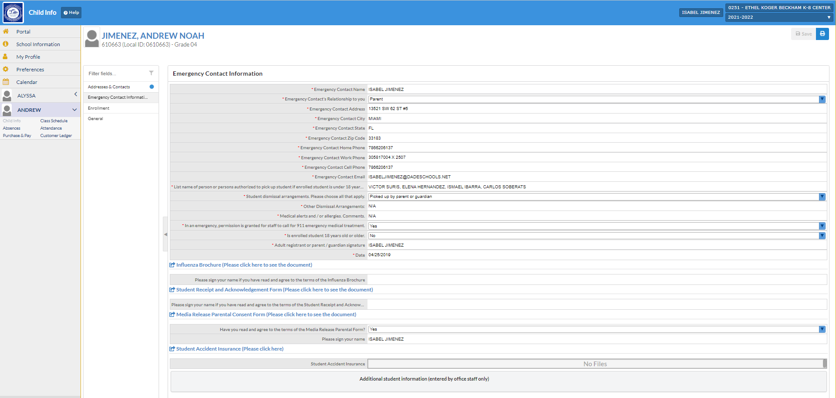
ALL DATA FIELDS IN THE STUDENT’S
“EMERGENCY CONTACT INFORMATION”
MUST BE COMPLETED OR THE REGISTRATION CANNOT BE “SAVED”.
The “Influenza Brochure” can be viewed and signed-off on.
The “student receipt and acknowledgement form” can be viewed and signed-off on.
The “media release parental consent form” can be viewed and signed-off on.
The “student accident insurance” is linked to
https://www.hsri.com/K12_Enrollment/Main/newAccount.asp
This application can be completed and paid for right here.
The parent can then upload the receipt or give it to your program manager prior to being granted full admission.
MIAMI-DADE COUNTY PUBLIC SCHOOLS
OFFICE OF COMMUNITY EDUCATION AND BEFORE / AFTER SCHOOL PROGRAMS
PAGE 12
Notes:
MEMO FOR YOUR TRAINING RECORD

Slide 13
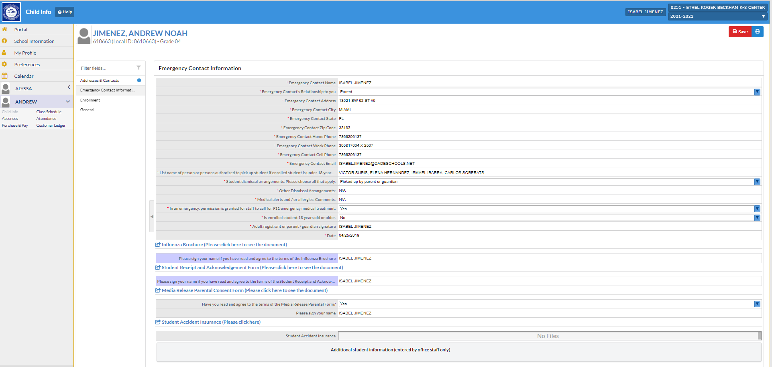
If a data field is highlighted in “pink” then it is incomplete.
If a data field is highlighted in “purple” then has been addressed but needs to be saved by clicking the red “save” Button.
MIAMI-DADE COUNTY PUBLIC SCHOOLS
OFFICE OF COMMUNITY EDUCATION AND BEFORE / AFTER SCHOOL PROGRAMS
PAGE 13
Notes:
MEMO FOR YOUR TRAINING RECORD

Slide 14
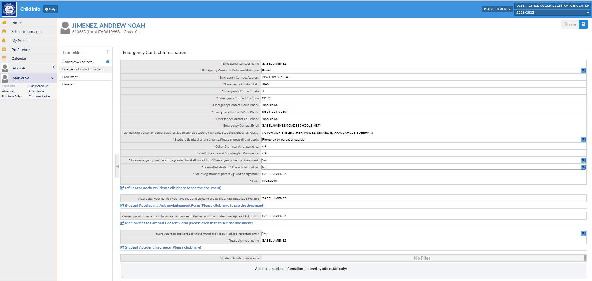
If the data fields are not highlighted in “pink” or “purple” then the students EMERGENCY CONTACT INFORMATION
has been completed.
Make sure the “save” button is no longer “red”.
Registration is now completed.
MIAMI-DADE COUNTY PUBLIC SCHOOLS
OFFICE OF COMMUNITY EDUCATION AND BEFORE / AFTER SCHOOL PROGRAMS
PAGE 14
Notes:
MEMO FOR YOUR TRAINING RECORD

Slide 15
Once Registration is complete, you may now pay for selected services by clicking on
“purchase and Pay”.
MIAMI-DADE COUNTY PUBLIC SCHOOLS
OFFICE OF COMMUNITY EDUCATION AND BEFORE / AFTER SCHOOL PROGRAMS
PAGE 15
Notes:
MEMO FOR YOUR TRAINING RECORD

Slide 16
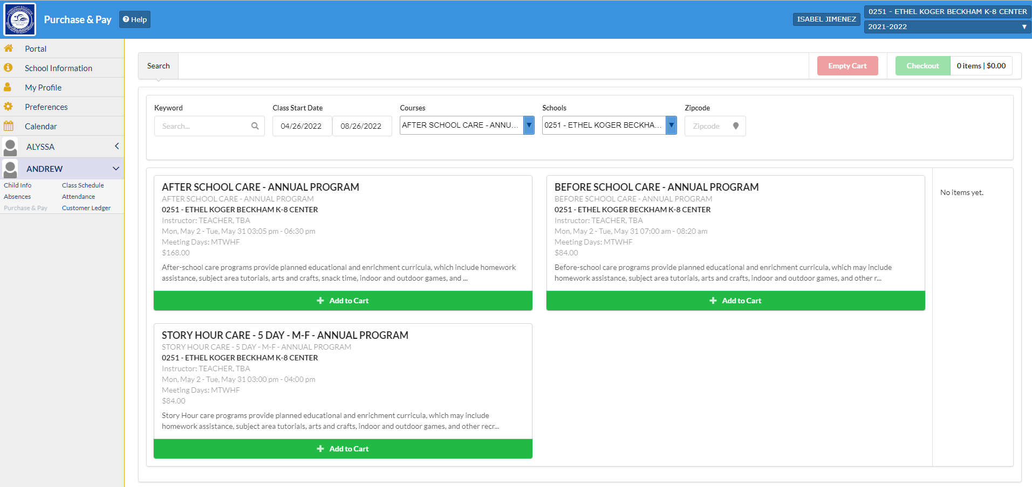
Now select the program that you WOULD like for your child to enroll IN and pay for.
MAKE SURE IT IS THE RIGHT SCHOOL AND PROGRAM.
NOW YOU ARE READY TO Click the green tab
“add to cart”
MIAMI-DADE COUNTY PUBLIC SCHOOLS
OFFICE OF COMMUNITY EDUCATION AND BEFORE / AFTER SCHOOL PROGRAMS
PAGE 16
Notes:
MEMO FOR YOUR TRAINING RECORD

Slide 17
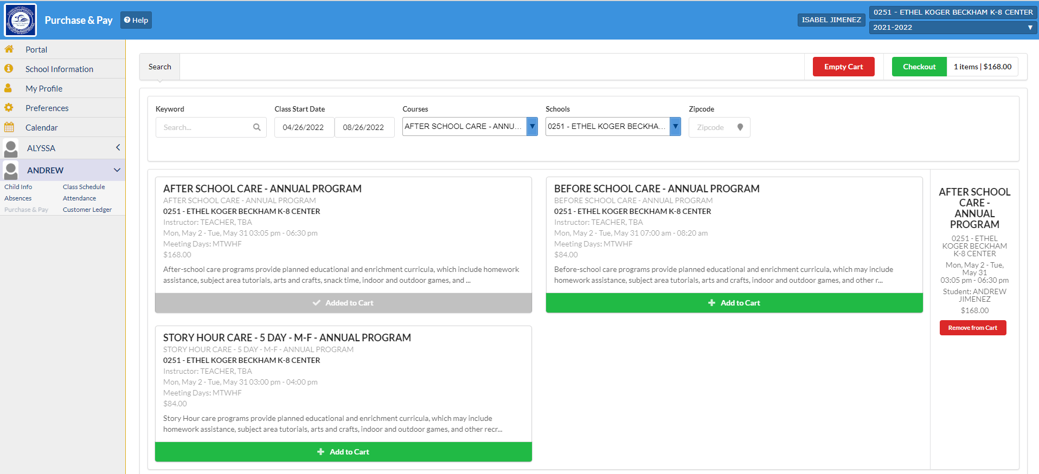
Now
Click the green tab THAT SAYS,
“CHECKOUT”
MIAMI-DADE COUNTY PUBLIC SCHOOLS
OFFICE OF COMMUNITY EDUCATION AND BEFORE / AFTER SCHOOL PROGRAMS
PAGE 17
Notes:
MEMO FOR YOUR TRAINING RECORD

Slide 18
ONCE AGAIN, MAKE SURE YOU HAVE THE RIGHT SCHOOL AND PROGRAM.
NOW YOU ARE READY TO Click the green tab
“CONTINUE”
MIAMI-DADE COUNTY PUBLIC SCHOOLS
OFFICE OF COMMUNITY EDUCATION AND BEFORE / AFTER SCHOOL PROGRAMS
PAGE 18
Notes:
MEMO FOR YOUR TRAINING RECORD

Slide 19
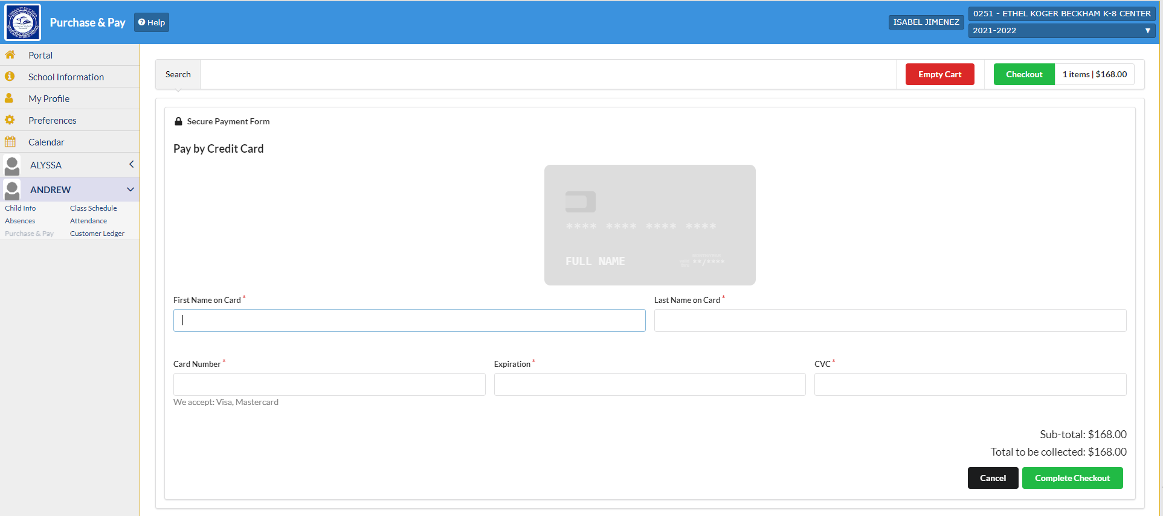
PLEASE FILL OUT THE DATA FIELDS NEEDED TO ENTER YOUr visa or mastercard CREDIT CARD INFORMATION.
Important:
By design, your Credit card information will not
Save or archive and will have to be entered each time you go to pay for a service.
NOW YOU ARE READY TO Click the green tab
“complete checkout”
After you submit, your receipt will BE sent to the email address that is linked to your m-dcps parent portal.
MIAMI-DADE COUNTY PUBLIC SCHOOLS
OFFICE OF COMMUNITY EDUCATION AND BEFORE / AFTER SCHOOL PROGRAMS
PAGE 19
Notes:
MEMO FOR YOUR TRAINING RECORD

Slide 20
PLEASE MAKE SURE THAT ALL AFTERCARE PARENTS / STUDENTS RECEIVE A HARD COPY OR HAVE A
WEB LINK TO YOUR SCHOOL SITES:
“BEFORE AND
AFTER SCHOOLCARE
PARENT HANDBOOK”
MIAMI-DADE COUNTY PUBLIC SCHOOLS
OFFICE OF COMMUNITY EDUCATION AND BEFORE / AFTER SCHOOL PROGRAMS
PAGE 20
Notes:
MEMO FOR YOUR TRAINING RECORD

Slide 21
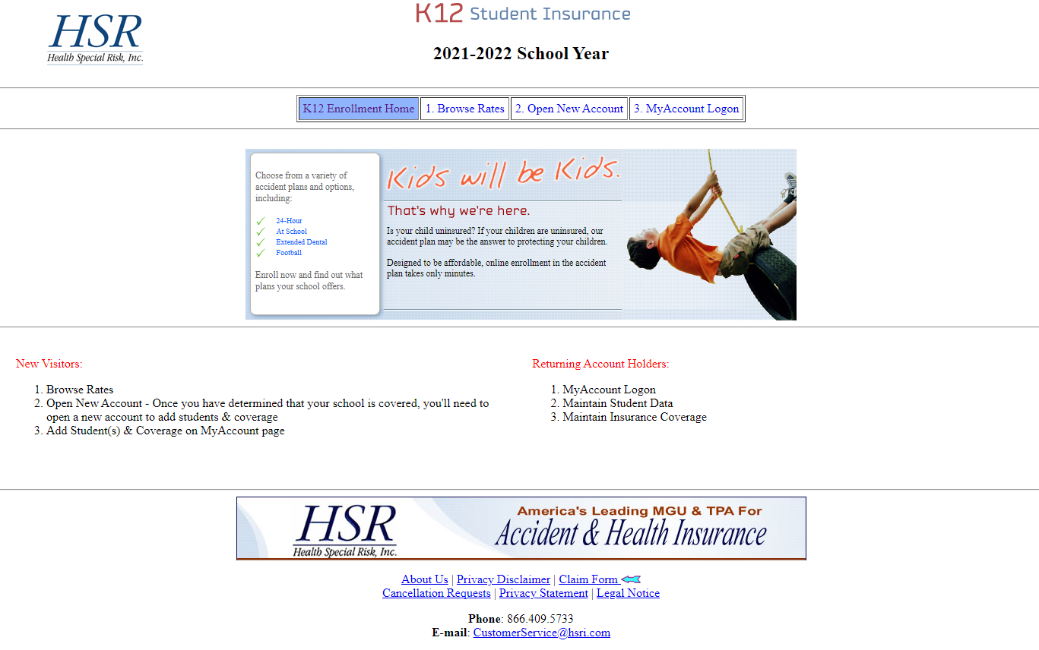
HEALTH SPECIAL RISK (HSR) service center: (866) 409-5733
Health special risk (Hsr)
student accident insurance
Phone: (866) 409-5733
Hsr Online Application website:
https://www.hsri.com/K12_Enrollment/Main/default.asp
MIAMI-DADE COUNTY PUBLIC SCHOOLS
OFFICE OF COMMUNITY EDUCATION AND BEFORE / AFTER SCHOOL PROGRAMS
PAGE 21
Notes:
MEMO FOR YOUR TRAINING RECORD

Slide 22
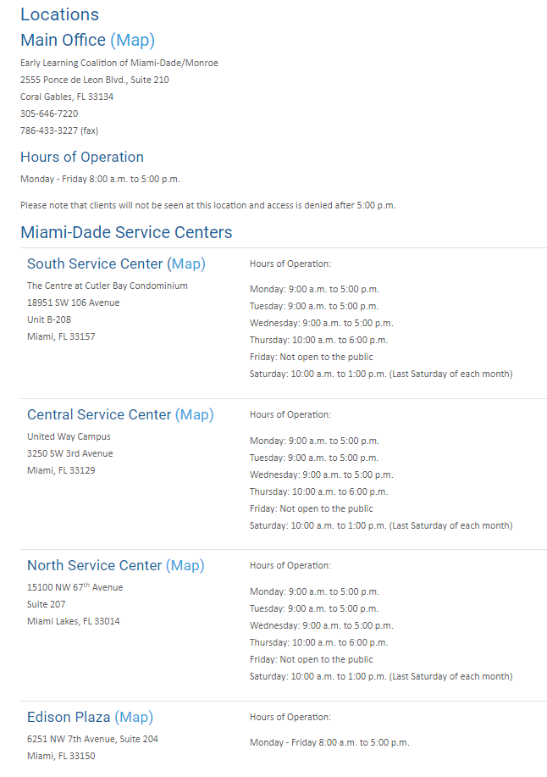
Early learning coalition (elc) service centers: (305) 646-7220
Early learning coalition (elc)
Vouchers for aftercare fee subsidies for students who qualify
Phone: (305) 646-7220
Elc Online Application website:
https://
www.elcmdm.org
MIAMI-DADE COUNTY PUBLIC SCHOOLS
OFFICE OF COMMUNITY EDUCATION AND BEFORE / AFTER SCHOOL PROGRAMS
PAGE 22
Notes:
MEMO FOR YOUR TRAINING RECORD

Slide 23
THE OFFICE OF COMMUNITY EDUCATION AND BEFORE AND AFTERSCHOOL PROGRAM STAFF ARE AVAILABLE TO STUDENTS, PARENTS, AND STAFF:
MONDAY THROUGH FRIDAY FROM
9:00 AM TO 4:30 PM
MIAMI-DADE COUNTY PUBLIC SCHOOLS
OFFICE OF COMMUNITY EDUCATION AND BEFORE / AFTER SCHOOL PROGRAMS
PAGE 23
Notes:
MEMO FOR YOUR TRAINING RECORD

